Slide 1

Collecting and Analyzing Large Data Project
Optimizing Spotify Music Discovery Experience
By Aman
Project Overview
Developing an innovative song recommeder feature to create a more personalized music discovery experience for Spotify users

Slide 2

Project Overview & Objectives
1
Enhance User Experience
2
Feature-Driven Optimization
Design an innovative feature for Spotify to improve user engagement through personalized music discovery experiences.
Develop new functionalities based on musical attributes (such as danceability, mood) to optimize music recommendation experience.
3
Data-Driven Design
Leverage the music recommendation system's ability to analyze song features and similarities to inform the design of new personalized discovery features, enhancing user engagement and creating tailored music exploration journeys.

Slide 3
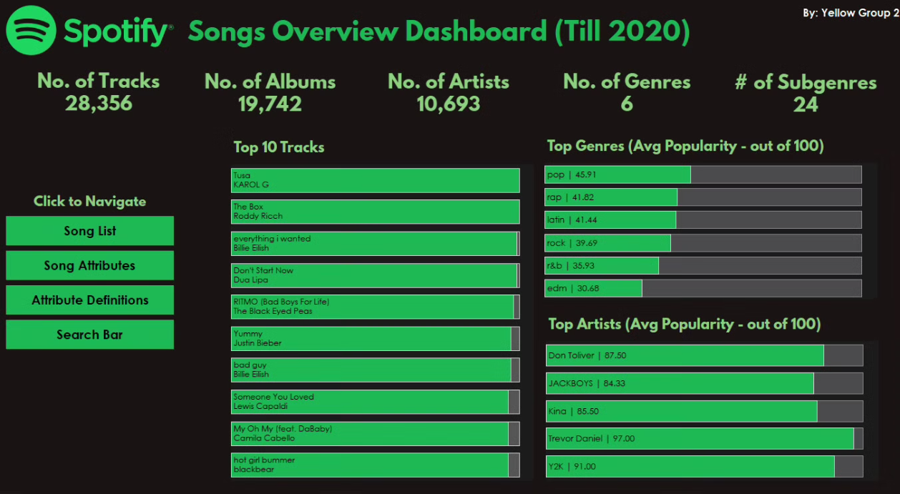
Database Summary
Analysis of more than 28000+ tracks on Spotify till 2020, reveals insights about music preferences and listening patterns:
1
Dataset Scale
2
Genre Performance
3
Top Performers
28,356 tracks (rows of data) across 6 genres and 24 subgenres, and varying attributes like danceability, energy, speechines, tempo, loudness, mode, speechiness, acousticness, instrumentalness, liveness and valence
Over 10,000 artists in genres like Pop, Rap, Rock and much more, visualised based on their average popularity. Genres are further subcaterized on the basis of Sub-Genres.
Information regarding artists like Trevor Daniel and Y2K who have achieved 90+ popularity scores, with hit tracks from KAROL G and Dua Lipa showing strong engagement.
Tableau Dashboard Main Page

Slide 4
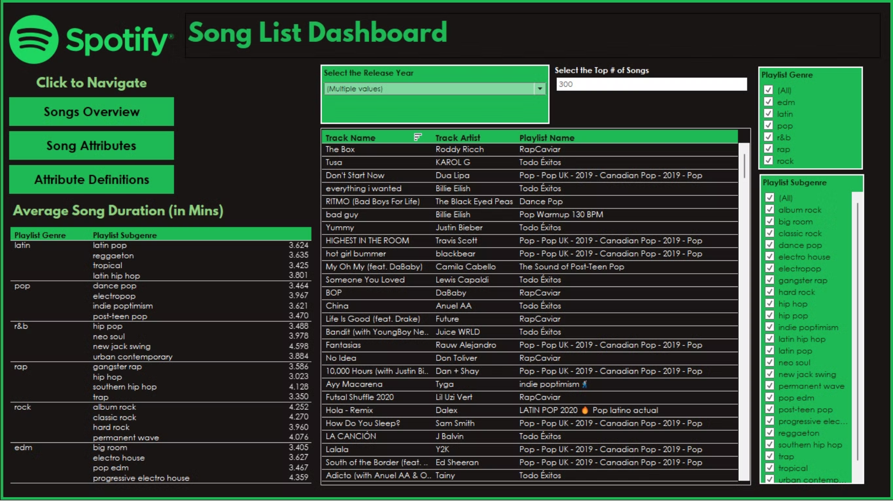
Here, the user can decide how many songs to display and can filter the displayed songs on release year, genres and sub genres
Song List Page

Slide 5
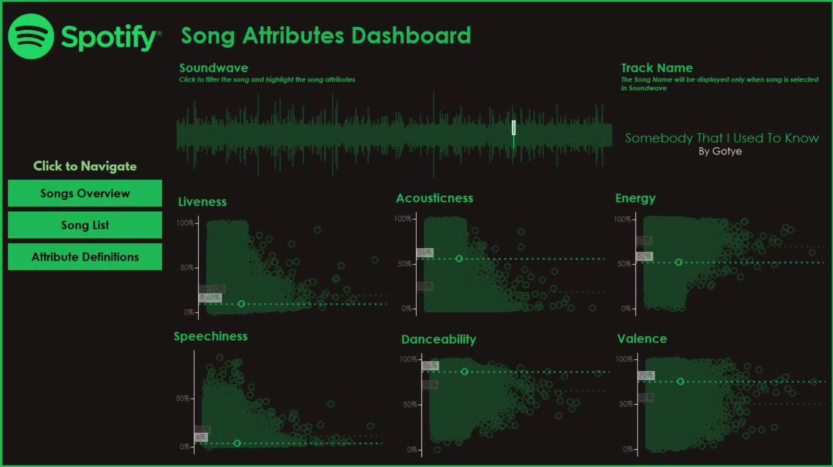
Song Attribute Page
Users can interact with the soundwave visualization by clicking anywhere on it. When a user selects a point on the soundwave, a specific song is chosen, and detailed information about that song's attributes is displayed. Additionally, the song's position is highlighted on a scatterplot, showing how its attributes compare to those of other songs in the database.

Slide 6
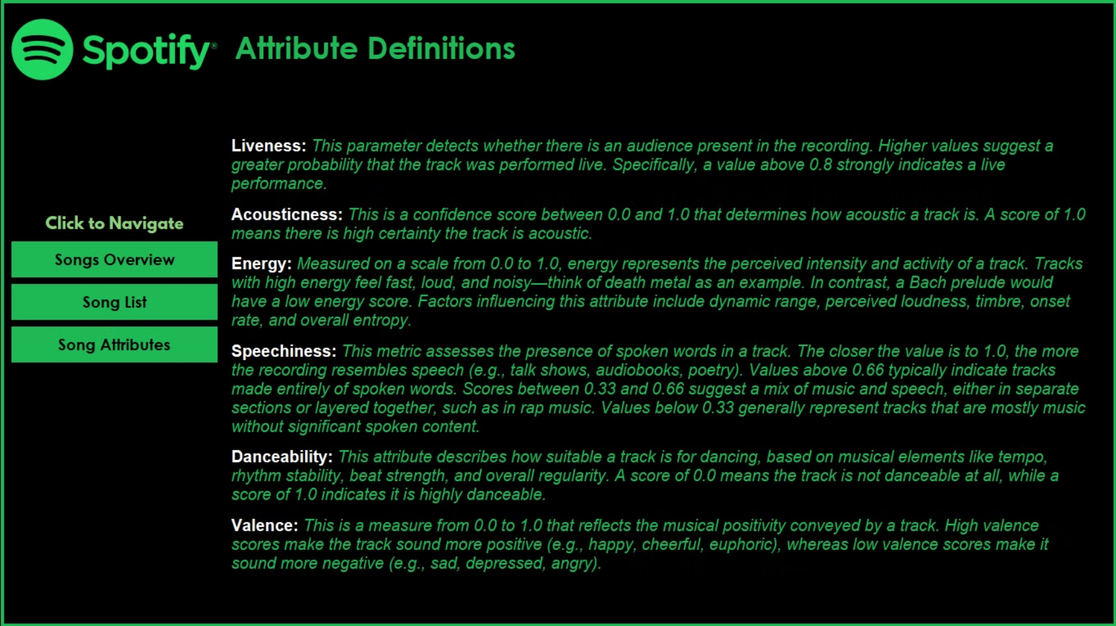
Attribute Definition Page

Slide 7
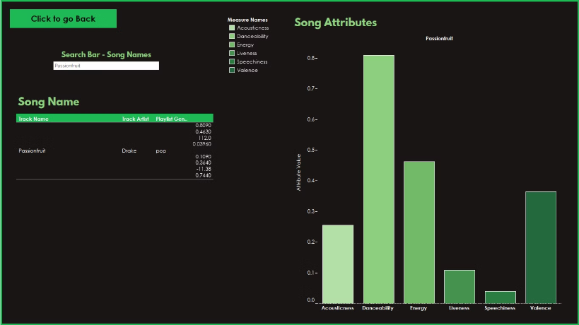
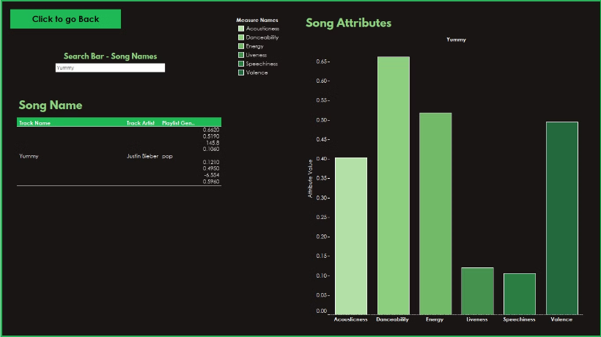
Search Bar Page
Users can look up a specific song they desire and receive detailed information about its various attributes.

Slide 8
Feature Demonstration
In this section, we will demonstrate our Song Recommender feature and how it functions, showcasing how they improve the music discovery experience for users.

Slide 9
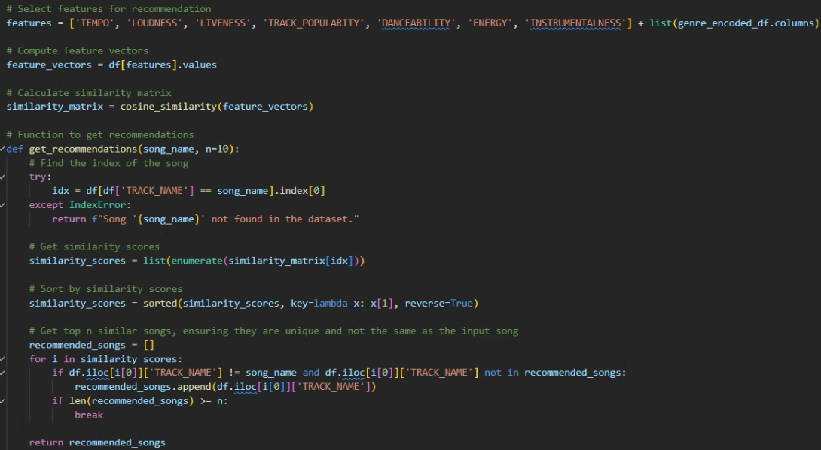
Code Implementation
Graphical User Interface (GUI):
Built with tkinter
Allows users to input a song name.
Includes sliders for adjusting various feature weights (e.g., tempo, loudness, popularity).
Recommendation Algorithm:
Uses cosine similarity to calculate the closest matches based on user input and selected weights.
Presents a list of recommended songs to the user.
Usability Enhancements:
If the entered song name doesn't exactly match any in the dataset, the program suggests the closest match.
Ensures a user-friendly experience by handling input discrepancies effectively.

Slide 10
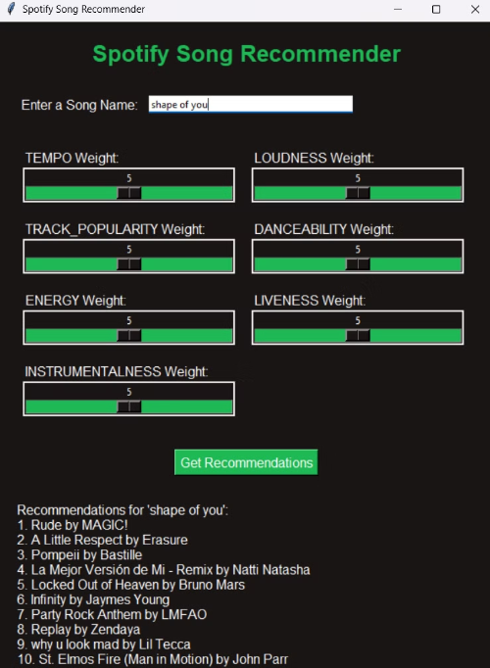
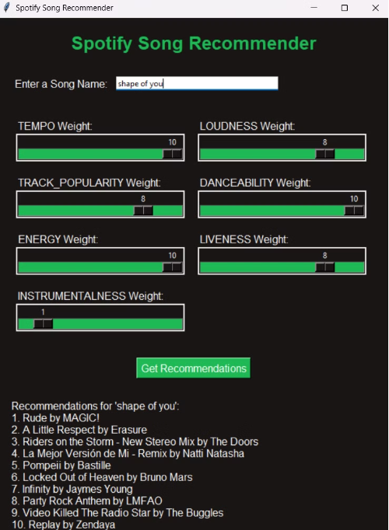
GUI Presentation
Same Weights
Personalized Weights

Slide 11
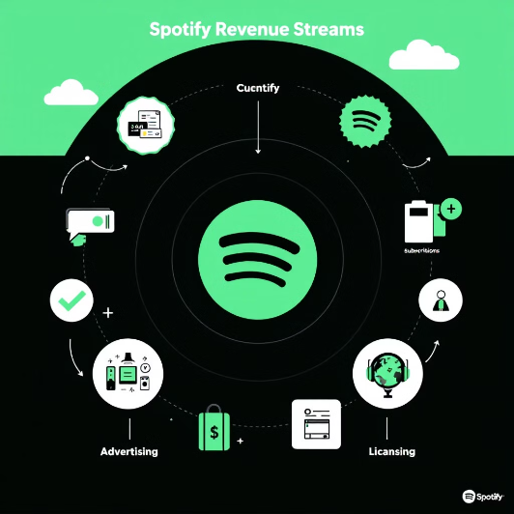
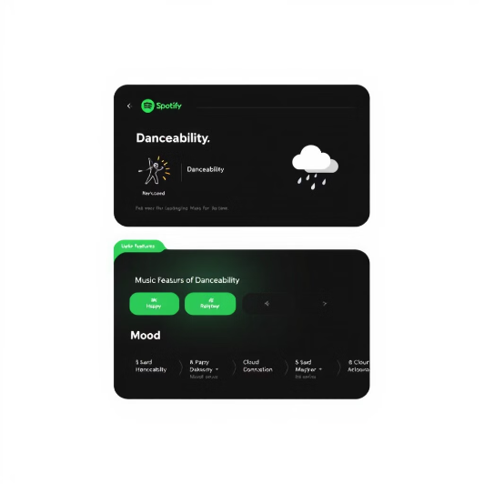
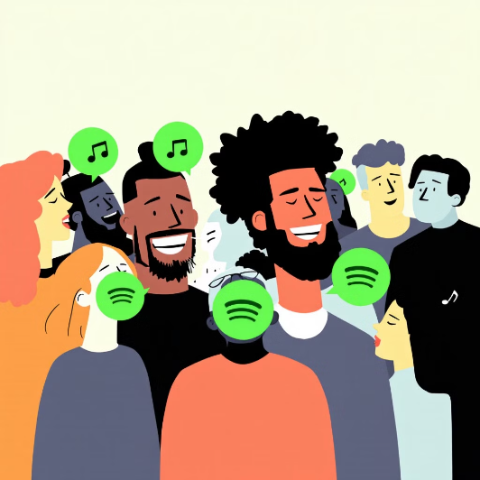
Business Opportunities and Target Users
Business Opportunities
Product Features
Target User Groups
Revenue generation through API subscription model
Music recommendations based on danceability
Music enthusiasts seeking personalized experiences
Data analytics services for music companies
Adjustable sliders based on preference
Explorers looking for new music

Slide 12



Feature Monetization Strategy
Premium Feature Integration
Partner Integration
Enhancing User Experience
Introduce advanced music mood and energy level filters as premium features, creating new revenue streams through enhanced subscription tiers.
Enable third-party applications to integrate our feature APIs, generating revenue through API licensing while expanding the ecosystem.
Provide enhanced music recommendations by leveraging feature-based similarity analysis, offering users a tailored and engaging listening experience. Users gain more control over their music journey with intuitive features that help them discover songs matching their exact preferences and current mood.
Notes:
Key talking points: Revenue potential through premium features, API partnerships, and increased user engagement metrics. Be prepared to discuss integration timeline and partnership opportunities.

Slide 13
Limitations
Dependence on Dataset Quality: The accuracy and relevance of recommendations are highly dependent on the completeness, diversity, and accuracy of the dataset used. If the dataset lacks variety or contains outdated information, the recommendations may not reflect current user preferences.
Exact Match Requirement: Although the project incorporates fuzzy matching, users may still face difficulties if the entered song name significantly deviates from the dataset's format, limiting accessibility for users unfamiliar with the exact titles.
Scalability Issues: The algorithm might face issues with scalability when applied to very large datasets, as the computation of similarity matrices can become resource-intensive, potentially leading to slower performance.

Slide 14
Thank You for Your Attention
Thank you very much for your interest!
Questions Welcome
We are happy to answer any questions
Open Discussion
Looking forward to in-depth conversations with you

